Slide 1
COMPREHENSIVE MOLECULAR DIAGNOSTICS AND ADVANCED GENE EXPRESSION ANALYSIS
By
Prof. Aritri Bir
Dr. B. C. Roy Multi-Speciality Medical Research Centre
Indian Institute of Technology Kharagpur
Module 4: Tools of Molecular diagnostics and Gene expression Analysis (III) Lecture 16: DNA Microarray

Slide 2
DNA microarray
Concept & Principle
Mechanism
Application

Slide 3
DNA microarray
DNA chips
Gene chips
DNA arrays
Gene arrays
Biochips
DNA microarray is the technology in which specific DNA sequences are orderly arranged on a surface to detect and quantify genes.

Slide 4
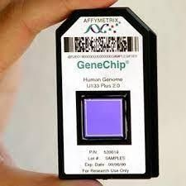
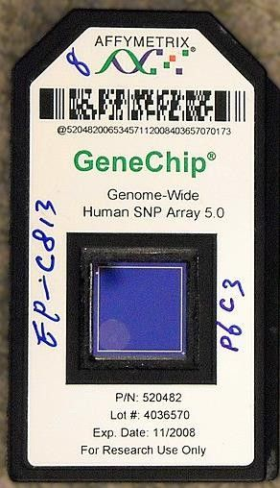
Principle: Nucleic acid hybridization based on complementarity (Chargaff's rule)
Evolved from Southern blotting
The use of miniaturized microarrays for gene expression profiling was first reported in 1995
The complete eukaryotic genome (Saccharomyces cerevisiae) on a microarray was published in 1997

Slide 5
Principle: Nucleic acid hybridization based on complementarity (Chargaff's rule)
Steps:
Manufacturing of DNA Chip containing synthetic single stranded DNA sequences.

Slide 6
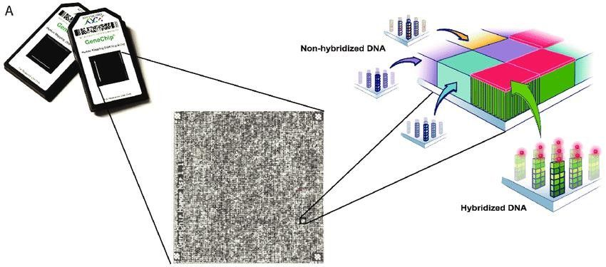
Principle: Nucleic acid hybridization based on complementarity (Chargaff's rule)
Steps:
Manufacturing of DNA Chip containing synthetic single stranded DNA sequences.
Kryh, Hanna. Molecular characterization of neuroblastoma tumors-a basis for personalized medicine. 2012.
Each spot (feature) contain a few million copies of identical DNA strands (probe) representing a single gene.

Slide 7
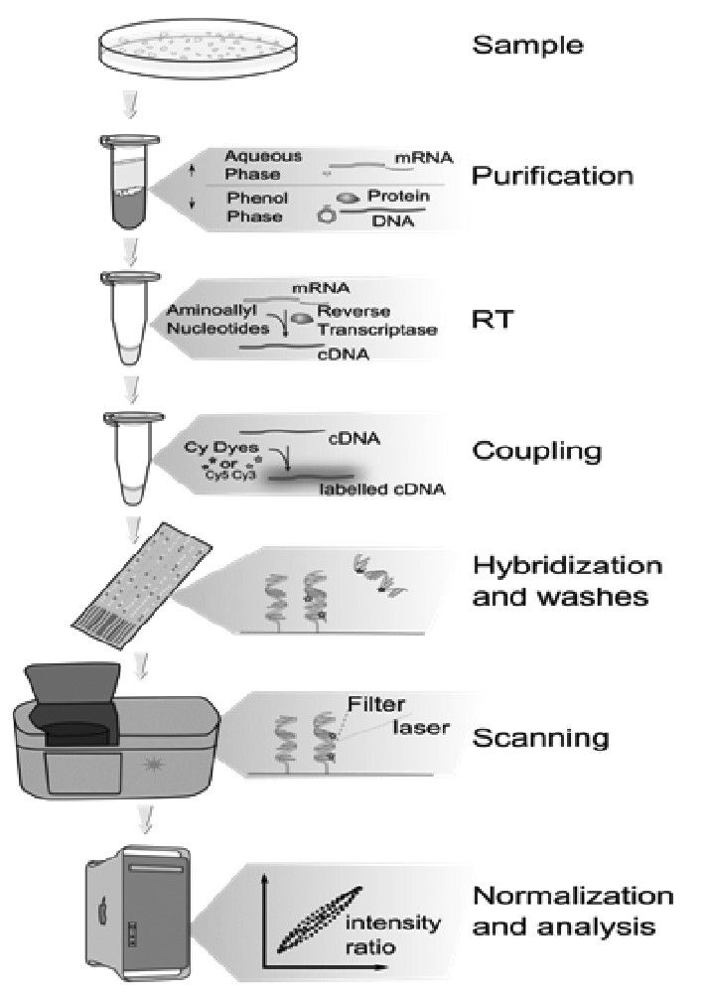
Principle: Nucleic acid hybridization based on complementarity (Chargaff's rule)
Steps:
Manufacturing of DNA Chip containing synthetic single stranded DNA sequences.
Isolation and preparation of Sample DNA - labeled with a fluorescent dye.
Hybridization into the chip.
The bound DNA will be detected by its fluorescent dye and analyzed by a computer.

Slide 8
Principle: Nucleic acid hybridization based on complementarity (Chargaff's rule)
A mixture of labeled nucleic acids (target) binds to the probes by hybridization on the array surface.
The presence/absence and relative concentrations of the nucleic acid species in solution can be measured.

Slide 9
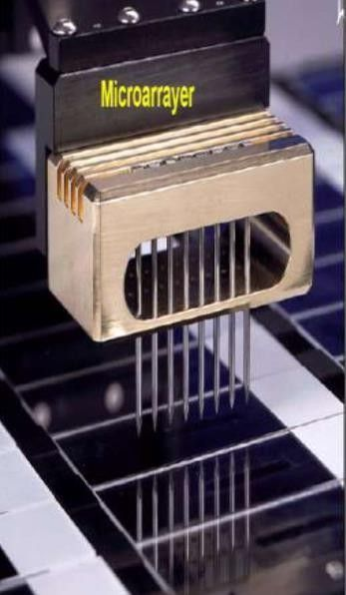
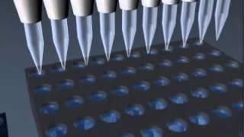
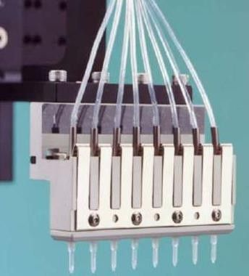
DNA Microarray types based on Fabrication process
 |  | Relatively inexpensive. Flexible Less time consuming High specificity, less flexibility costly specialized machinery to synthesize the arrays
Spotted | Probes are oligonucleotides, cDNA PCR products The pre-synthesized probes are deposited or "spotted" on the array surface. Pen tip method or Inkjet method Robotic arm
In-situ | Printing/synthesizing the probe directly onto the array surface Photolithography / Inkjet Short oligonucleotide sequences High density

Slide 10
DNA Microarray types based on Fabrication process
Spotted | Probes are oligonucleotides, cDNA PCR products The pre-synthesized probes are deposited or "spotted" on the array surface. Pen tip method or Inkjet method Robotic arm | Relatively inexpensive. Flexible
In-situ | Printing/synthesizing the probe directly onto the array surface Photolithography / Inkjet Short oligonucleotide sequences High density | Less time consuming High specificity, less flexibility costly specialized machinery to synthesize the arrays

Slide 11
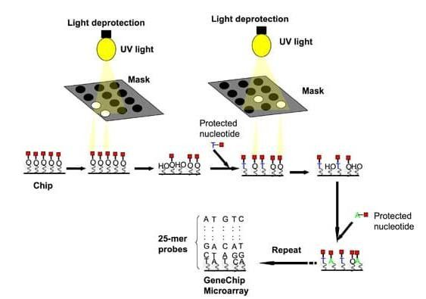
In-situ DNA microarray - Photolithography
In-situ synthesized arrays are high-density oligonucleotide probe DNA microarrays
Synthesizes probes directly on the surface of the array
one nucleotide at a time per spot, for many spots simultaneously
Affymetrix GeneChip arrays most common.
UV light is directed through a photolithographic mask
The mask is designed in such a way that the exposure sites can be chosen as per requirement
Addition of nucleotide occurs only on the chosen unprotected/unmasked sites.
Deprotect and activate selected sites with hydroxyl groups
Coupling
Solid support
Covalent linker molecules Protecting group on the free end (removable by light)

Slide 12
In-situ DNA microarray - Photolithography
The process is repeated
New mask is applied activating different sets of sites and coupling different bases
Each probe on the chip requires four masks per round of synthesis: one mask to allow addition of the required base and three other masks to prevent light from deprotecting the same spot while the other three nucleotides are being added.
Deprotect and activate selected sites with hydroxyl groups
Coupling
Solid support
Covalent linker molecules Protecting group on the free end (removable by light)

Slide 13
In-situ DNA microarray – Inkjet spotting process
Five “ink” printing
4 nucleotide precursors plus catalyst
combined with coupling and deprotection steps
Photolithographic masks not required.
Printing picoliter volumes of nucleotides on the array surface in repeated rounds of base-by-base printing that extends the length of specific oligonucleotide probes.
Synthesis of longer molecules (60-mer length oligos) for their probes.

Slide 14
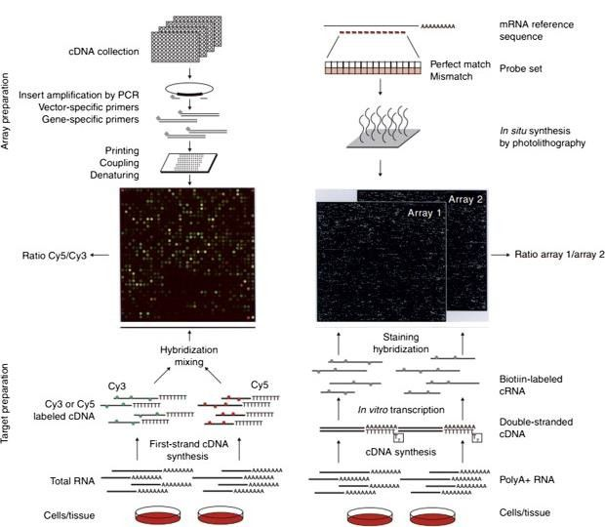
cDNA probe vs Oligonucleotide probe
Wilson, Ann S., et al. "The microarray: potential applications for ophthalmic research." Mol Vis 8 (2002): 259-270.

Slide 15
Applications of DNA Microarray
Gene expression and profiling:
Presence and absence of specific genes
compare genes from different sources and to know how the external genes affect the external stimuli. gene expression pattern of different diseases such as cancer.
Effect of certain treatments, diseases and developmental stage on gene expression.
Dynamic changes in gene expression under different conditions help to understand cellular processes, signaling pathways, and the regulatory mechanisms governing gene activity.
Comparative Genomic Hybridization: Genomic DNA is fluorescently labeled and used to determine the
presence of gene loss or amplification

Slide 16
Applications of DNA Microarray
Disease Diagnosis and Classification: specific gene signatures associated with different diseases
Biomarker discovery Genetic Counseling and Prenatal Screening:
Analysis of fetal DNA
Genetic counseling
Cancer Research and Profiling:
Molecular signatures of different types of cancer
Identify genetic variations and expression patterns associated with specific cancer subtypes
Functional Genomics:
systematic analysis of gene functions.
Identification of genes involved in specific biological processes
Gene interactions
Functional roles of genes within cellular pathways
Infectious Disease Monitoring:
Monitor and study the genetic variations of infectious agents
Identification and classification of pathogens
Tracking disease outbreaks
Understanding drug resistance mechanisms
Pharmacogenomics:
Comparative analysis of genes to identify specific proteins produced by diseased cell
Synthesis of drug
Personalized medicine

Slide 17
Limitations of DNA Microarrays:
Measurement is dependent on assay kinetics and linearity range
Chances of cross-hybridization
Difficulty in detection of individual members of gene families or splice variants
Difficulty in detection on non-coding regions
Reference strain bias
Limited genome coverage

Slide 18
Summary:
Nucleotide hybridization
In-situ and spotted technique
Role in cancer diagnostics and personalized medicine.

Slide 19
Wilson, K. and Walker, J. (2010) Principles and Techniques of Biochemistry and Molecular Biology. Cambridge University Press, Cambridge.
Nelson, D. L., & Cox, M. M. (2017). Lehninger principles of biochemistry (7th ed.). W.H. Freeman.
Sambrook, J. and Russell, D.W. (2001) Molecular Cloning: A Laboratory Manual. 3rd Edition, Vol. 1,
Cold Spring Harbor Laboratory Press, New York.
Molecular Diagnostics: Techniques and Applications for the Clinical Laboratory" by Wayne W. Grody and Robert M. Nakamura
Govindarajan R, Duraiyan J, Kaliyappan K, Palanisamy M. Microarray and its applications. J Pharm Bioallied Sci. 2012;4(Suppl 2):S310-S312. doi:10.4103/0975-7406.100283
Bumgarner R. Overview of DNA microarrays: types, applications, and their future. Curr Protoc Mol Biol. 2013;Chapter 22:Unit-22.1.. doi:10.1002/0471142727.mb2201s101

Slide 21
COMPREHENSIVE MOLECULAR DIAGNOSTICS AND ADVANCED GENE EXPRESSION ANALYSIS
By
Prof. Aritri Bir
Dr. B. C. Roy Multi-Speciality Medical Research Centre
Indian Institute of Technology Kharagpur
Module 4: Tools of Molecular diagnostics and Gene expression Analysis (III) Lecture 17: FISH ( Fluorescence in situ Hybridization)

Slide 22
Fluorescence in situ Hybridization
Concept & Principle
Mechanism
Application

Slide 23
Fluorescence in-situ Hybridization
In situ hybridizations are molecular cytogenetic method used for detection and localization of a specific DNA sequence inside a cell (in situ).
First in situ hybridization experiments in 1969 (Gall & Pardue, 1969)
FISH - In situ hybridization technique where the probe is tagged with fluorophore
Principle:
“Probe”— small piece of purified DNA tagged with a fluorescent dye finds and then binds to its matching (complementary) sequence within the set of chromosomes.

Slide 24
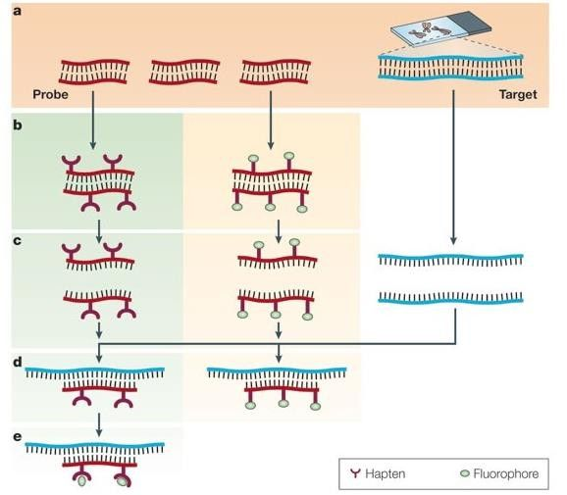
Principle of fluorescence in situ hybridization
PROBE (Labelled) indirectly with a hapten/ directly with fluorophore
Direct labelling: fluorescein (fluorescein isothiocyanate, FITC), rhodamine, Cy2, Cy3, Cy5, and AMCA.
Indirect labelling: biotin, digoxigenin, and dinitrophenol.
Nick translation
Random primer labeling
PCR using tagged nucleotide
Speicher MR, Carter NP. The new cytogenetics: blurring the boundaries with molecular biology. Nat Rev Genet. 2005;6(10):782-792. doi:10.1038/nrg1692

Slide 25
Principle of fluorescence in situ hybridization
PROBE (Labelled) indirectly with a hapten/ directly with fluorophore
SAMPLE
DNA of either interphase cells or of metaphase chromosomes
Denaturation
annealing of complementary DNA sequences
Fluorescence microscopy
Indirect labelling :
Enzymatic : fluorochrome emitting colored signals at the hybridization site
Immunological : based on binding of antibodies to specific antigens.
Speicher MR, Carter NP. The new cytogenetics: blurring the boundaries with molecular biology. Nat Rev Genet. 2005;6(10):782-792. doi:10.1038/nrg1692

Slide 26
The process is done in 3 main procedures:
Tissue preparation (pre-hybridization)
Hybridization
Washing (post-hybridization) and Detection
Frozen sections
Paraffin embedded sections
Cells in suspension
Hybridization and Washing:-
The hybridization is done by mixing the single strand probes with the denaturated target DNA.
Denaturation by heating
Overnight incubation
Serial washing to remove the unbound probe.

Slide 27
Type of Probes
Chromosome painting probes | Repetitive sequence probes | Locus-specific probes
Chromosome-specific composite probe pools DNA probes derived from a single type of chromosome (PCR amplified & labelled) Homogenous “paint” to highlights the entire chromosome. Visualization of individual chromosomes in metaphase or interphase cells Identification of chromosomal aberrations. Simultaneous painting of every human chromosome in 24 colors. | Specific chromosomal regions or structures that contain short sequences Pan-telomeric probes target the tandemly repeated (TTAGGG) sequences Centromeric probes target the α- and β-satellite sequences flanking the centromeres Monosomy, trisomy, and other aneuploidies in leukemias and solid tumors | Genomic cloned probes to particular region of chromosome Detection of translocations, inversions, and deletions in both metaphase and interphase.

Slide 28
Type of Probes
Chromosome painting probes
Repetitive sequence probes
Locus-specific probes
Chromosome-specific composite probe pools
DNA probes derived from a single type of chromosome (PCR amplified & labelled)
Homogenous “paint” to highlights the entire chromosome.
Visualization of individual chromosomes in metaphase or interphase cells
Identification of chromosomal aberrations.
Simultaneous painting of every human
chromosome in 24 colors.
Specific chromosomal regions or structures that contain short sequences
Pan-telomeric probes target the tandemly repeated (TTAGGG) sequences
Centromeric probes target the α- and β-satellite sequences flanking the centromeres
Monosomy, trisomy, and other aneuploidies in leukemias and solid tumors
Genomic cloned probes to particular region of chromosome
Detection of translocations, inversions, and deletions in both metaphase and interphase.

Slide 29
Type of Probes
Chromosome painting probes | Repetitive sequence probes | Locus-specific probes
Chromosome-specific composite probe pools DNA probes derived from a single type of chromosome (PCR amplified & labelled) Homogenous “paint” to highlights the entire chromosome. Visualization of individual chromosomes in metaphase or interphase cells Identification of chromosomal aberrations. Simultaneous painting of every human chromosome in 24 colors. | Specific chromosomal regions or structures that contain short sequences Pan-telomeric probes target the tandemly repeated (TTAGGG) sequences Centromeric probes target the α- and β-satellite sequences flanking the centromeres Monosomy, trisomy, and other aneuploidies in leukemias and solid tumors | Genomic cloned probes to particular region of chromosome Detection of translocations, inversions, and deletions in both metaphase and interphase.

Slide 30
APPLICATION OF FISH
Gene Mapping and Detection of Chromosome Aberration:
Target DNA intact
Information about the correct positions
Target nuclear RNA and genes within cells (Transcription and transport) by RNA- FISH
Nuclear organization - high-resolution information about gene position and relationships during different cell cycle stages.
Chromosomal deletions, disomy, imprinting, translocations
Comparative Genomic Hybridization (CGH)

Slide 31
APPLICATION OF FISH
Cancer Diagnosis and Subtyping:
Applicability in wide range of tissue types
Identify specific chromosomal abnormalities or gene amplifications associated with various types of cancer.
Monitoring Minimal Residual Disease by detecting residual cancer cells with specific genetic abnormalities.
Prenatal Genetic Testing:
Visualization of specific chromosomal abnormalities in fetal cells.
Down syndrome, trisomy 18, and trisomy 13
Microbial Detection and Identification:
Rapid and specific detection of microbial pathogens in clinical samples by targeting the nucleic acid sequences
Human Papillomavirus (HPV) Detection: early diagnosis of cervical cancer.
Pharmacogenomics Research: Study genetic variations affecting drug response.

Slide 32
Multiplex-FISH (M-FISH):
Simultaneous identification of multiple chromosomal regions or genes using distinct colors for each target.
Unique combination of fluorophores for each probe, allowing for comprehensive chromosomal analysis.
Each probe is labeled with a specific combination of five spectrally separable fluorochromes
Initially, M-FISH was designed for the simultaneous detection of all 24 human chromosomes
Adapted to specific chromosomal subregions, such as centromeres and sub-centromeres
Multilocus FISH (ML-FISH) - simultaneous use of multiple probes in multicolor FISH.
D- FISH (Double colour FISH) - Dual colour probes can be used to develop secondary colour on overlapping.

Slide 33
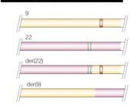
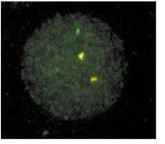
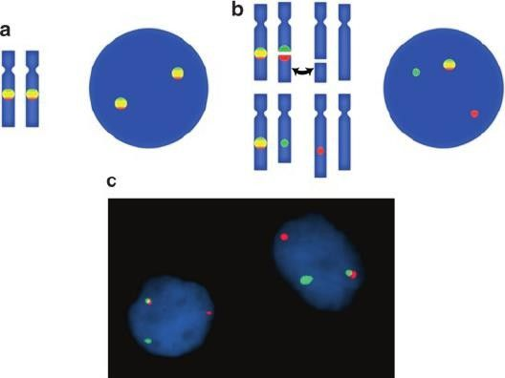
O'Connor, C. (2008) Fluorescence in situ hybridization (FISH). Nature Education 1(1):171
S.E. Pambuccian and R.H. Bardales, Lymph Node Cytopathology,Essentials
of .
in Cytopathology 10, DOI 10.1007/978-1-4419-6964-4_2,
D- FISH (Double colour FISH) - Dual colour probes can be used to develop secondary colour on overlapping.
Presence of secondary colour : detection of BCR/ABL translocations, where the secondary color indicates disease.
Absence of secondary color is pathological - “Break-apart FISH” - Locus-specific probes for one side of the breakpoint and the other intact chromosome. In normal cells secondary color is observed, but only the primary colors are observed when the translocation occurs.

Slide 34
Quantitative Fluorescent in situ Hybridization (Q-FISH):
Quantitative information about the abundance or characteristics of specific sequences.
Commonly used to measure the length of telomeres (cellular aging, cancer)
Peptide nucleic acid (PNA) probes - synthetic DNA analog with a neutral peptide backbone that enhances probe stability and binding affinity.
RNA-FISH:
Simultaneous detection, localization, and quantification of individual mRNA molecules either in the nucleus or cytoplasm at the cellular level in fixed samples.
allelic-specific expression on a single-cell basis
Stellaris RNA FISH (Single-Molecule RNA FISH) – single molecule of mRNA detection and quantification.
Immuno-FISH is a combination of standard FISH and indirect or direct immunofluorescence.
Flow-FISH - the in situ hybridization is combined with flow cytometry for measurement of the telomeric signals from cells in suspension. The PNA-labeled telomere probes.
Fiber fish: High resolution mapping of chromosome fibers - stretched over slides.

Slide 35
Summary:
Detection of gene/DNA sequence in situ
Different types of probes
Cancer diagnostics.
Chromosomal anomaly detection

Slide 36
Wilson, K. and Walker, J. (2010) Principles and Techniques of Biochemistry and Molecular Biology. Cambridge University Press, Cambridge.
Nelson, D. L., & Cox, M. M. (2017). Lehninger principles of biochemistry (7th ed.). W.H. Freeman.
Sambrook, J. and Russell, D.W. (2001) Molecular Cloning: A Laboratory Manual. 3rd Edition, Vol. 1,
Cold Spring Harbor Laboratory Press, New York.
Molecular Diagnostics: Techniques and Applications for the Clinical Laboratory" by Wayne W. Grody and Robert M. Nakamura
Speicher MR, Carter NP. The new cytogenetics: blurring the boundaries with molecular biology. Nat Rev Genet. 2005;6(10):782-792. doi:10.1038/nrg1692
O'Connor, C. (2008) Fluorescence in situ hybridization (FISH). Nature Education 1(1):171
S.E. Pambuccian and R.H. Bardales, Lymph Node Cytopathology,Essentials in Cytopathology 10, DOI 10.1007/978-1-4419-6964-4_2,
Shakoori AR. Fluorescence In Situ Hybridization (FISH) and Its Applications. Chromosome Structure and Aberrations. 2017;343-367. Published 2017 Feb 10. doi:10.1007/978-81-322-3673-3_16

Slide 38
COMPREHENSIVE MOLECULAR DIAGNOSTICS AND ADVANCED GENE EXPRESSION ANALYSIS
By
Prof. Aritri Bir
Dr. B. C. Roy Multi-Speciality Medical Research Centre
Indian Institute of Technology Kharagpur
Module 04: Tools of Molecular diagnostics and Gene expression Analysis (III) Lecture 18: Methods to study DNA-protein interaction I

Slide 39
In vitro techniques to study DNA–protein interaction
In vivo techniques to study DNA–protein interaction

Slide 40
DNA –Protein Interaction:
Fundamental Understanding of Gene Regulation
Cellular Processes and Function: DNA replication, transcription, translation, and repair.
Aberrant DNA-protein interactions innumerous diseases, including cancer, neurodegenerative disorders, and genetic diseases.
Many drugs target proteins involved in DNA-protein interactions.
Biotechnology and Genetic Engineering: Techniques like gene editing (e.g., CRISPR-Cas9) and gene expression manipulation rely on the precise control of DNA-protein interactions.

Slide 41
Methods
In vitro techniques to study DNA– protein interaction
Footprinting assay
Electrophoretic mobility shift assay (EMSA)
Southwestern blotting
Yeast one-hybrid assay (Y1H)
Phage display for DNA-binding proteins
In vivo techniques to study DNA– protein interaction
Chromatin immunoprecipitation (ChIP)
X-ChIP
Native-ChIP (N-ChIP)
Carrier ChIP

Slide 42
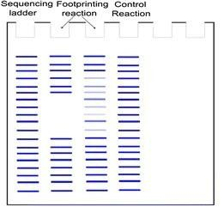
Foot printing assay
Principle: Protein bound to DNA protects from degradation.
Identification of specific sequence to which a DNA-binding protein or molecule binds.
Chemical or enzymatic (DNAse) digestion of naked and protein bound-DNA.
Both the reactions are then compared using gel electrophoresis.
The segment of the DNA bound by the protein appears as an empty stretch ‘footprint’ in the protein-bound reaction when compared to the continuous fragments produced by naked DNA digestion.
By varying the concentration of the DNA-binding protein, the binding affinity of the protein can be estimated according to the minimum concentration of protein at which a footprint is observed.

Slide 43
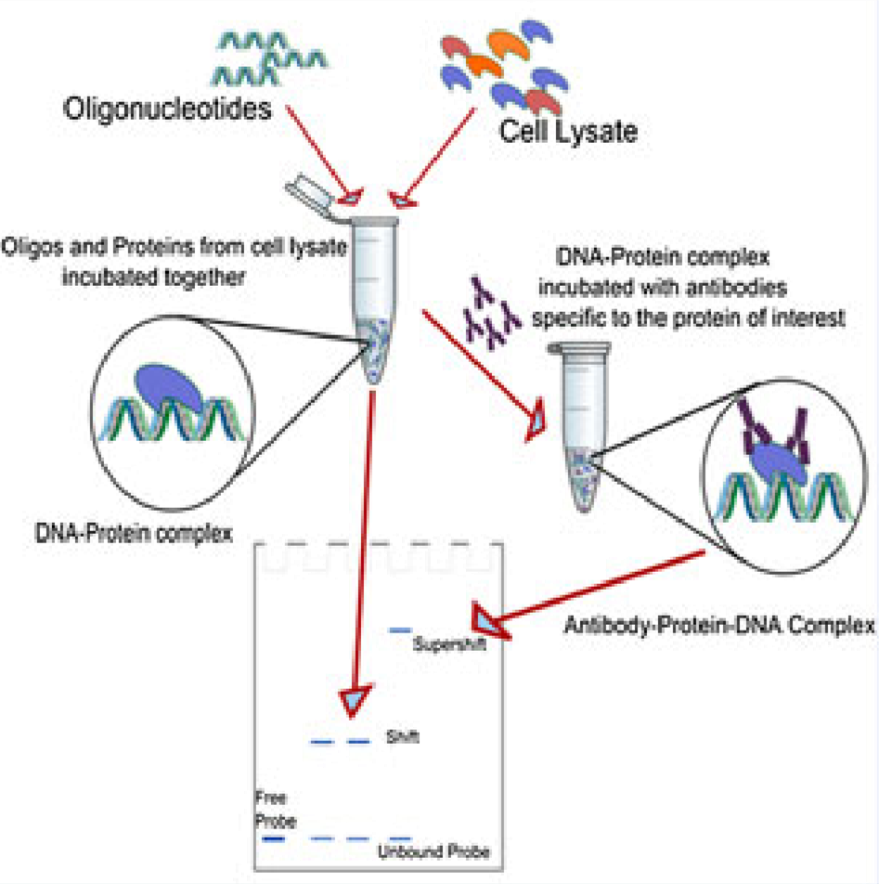
Electrophoretic mobility shift assay (EMSA)
Electrophoretic separation of a protein–DNA or protein–RNA mixture on a polyacrylamide or agarose gel.
Principle: DNA–protein complexes are heavier and move
slowly when subjected to non-denaturing polyacrylamide or
agarose gel electrophoresis as compared to unbound free probe.
Gel shift or gel retardation assay.
The DNA probes used may be radiolabeled or dyes specific to stain DNA and protein
The control lane (DNA probe without protein present) will contain a single band corresponding to the unbound DNA.
The lane with a protein bound DNA will produce band that
represents the larger, less mobile complex of nucleic acid
probe bound to protein which is 'shifted' up on the gel (since it has moved more slowly).

Slide 44
Electrophoretic mobility shift assay (EMSA)
Supershift assay: an antibody specific to the protein of interest.
Capillary electrophoretic mobility shift assay (CEMSA):
separation and quantitation of DNA–protein interactions in uncoated capillaries with no gel matrixes
High-sensitivity laser-induced-fluorescence detection of fluorescein- labeled DNA.
Capillary electrophoresis separates analytes on the basis of their mass- to-charge ratio and elutes complexes in the order of free protein, protein/DNA complex, and lastly DNA.
IDEMSA: (EMSA combined with immunodepletion and supershift assays)
The nuclear or cytoplasmic extracts are depleted of the specific protein by incubation with the relevant antibody and protein A-sepharose.
The depleted extracts are then analyzed for the presence of protein by the EMSA and supershift assay.

Slide 45
Southwestern blotting
Principle: Combines principles of Southern and Western blotting.
Used to elucidate the molecular weight of proteins in protein-DNA complexes.
Particularly useful when no antibodies are known for the bound protein.

Slide 46
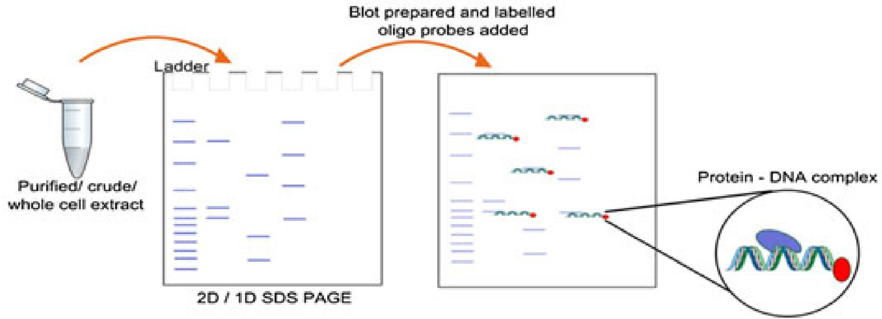
Southwestern blotting
Experimental Procedure:
Labeled oligonucleotides instead of antibodies as probes.
Crude or purified extracts are resolved on SDS-PAGE.
Proteins transferred to a membrane under conditions favoring renaturation.
Membrane-bound proteins incubated with oligonucleotides to which the protein of interest putatively binds.
Developed membrane photographed; only the band corresponding to the bound oligo appears in the final picture.
Using differently labeled oligos on the same blot provides information on the binding affinity of various mutants.

Slide 47
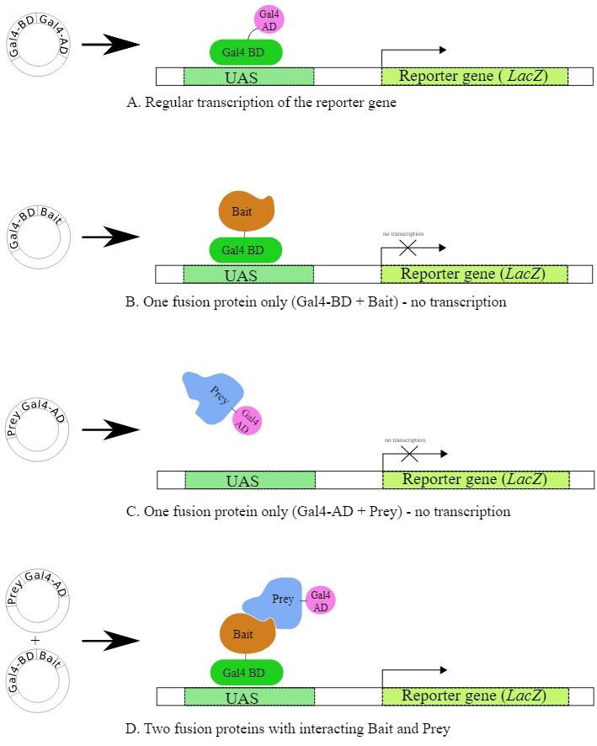
Yeast one-hybrid assay (Y1H)
Modification of the yeast-two hybrid (Y2H) assay
Most eukaryotic transcription factors - activation domain (AD) and the DNA-binding domain (DB) (physically separable).
AD and DB if separated : functionally inactive transcription factor (No RNA polymerase recruitment at promoter site)
Protein X is translationally fused to AD (Prey)
Protein Y is translationally fused to DB (Bait)
Both are expressed in the same yeast cell.
On X-Y interaction - the AD and DB in close physical proximity to reconstitute the functionally active transcription factor
expression of a downstream reporter gene.

Slide 48
Yeast one-hybrid assay (Y1H)
The bait - DNA sequence of our interest
Interaction of a protein X with the bait sequence is assayed.
If X interacts with the bait DNA sequence, it results in bringing AD-X fusion close to the promoter, allowing AD to activate the RNA polymerase and result in the expression of the downstream reporter gene.
Since this assay contains only one-hybrid encoded on a vector, it is called the ‘Y1H’.
Detection of the DNA–protein interaction occurs while proteins are in their native configurations – high sensitivity

Slide 49
Phage display for DNA-binding proteins
Phage display refers to the method of expressing a peptide or protein domain on a bacteriophage capsid by genetically fusing its amino acid sequence to that of the coat proteins encoded by the phage.
Phage-display library - affinity purification using an appropriate ligand
Affinity purification - dsDNA oligos (with the binding sequence specific to a protein) bound to a solid matrix.
The phage that displays a protein that binds to dsDNA oligo will remain bound to matrix while others are removed by washing.
Those that remain can be eluted and will be used to produce more phage (by bacterial infection with helper phage)
The identity of the selected clones can be obtained by sequencing the phage genome.

Slide 50
Summary:
In vitro techniques to study DNA–protein interaction
Footprinting assay - DNA-binding proteins protect specific DNA sequences from
degradation; identification achieved through chemical or enzymatic digestion, and gel electrophoresis reveals footprints indicating protein binding.
Electrophoretic mobility shift assay (EMSA) - Electrophoretic separation of protein–DNA or
protein–RNA complexes on polyacrylamide or agarose gel using gel shift assay, where
slower migration indicates protein binding, visualized with radiolabeled or dye-stained DNA probes.
Southwestern blotting -The method employs labeled oligonucleotide probes in a hybrid
approach, integrating SDS-PAGE and membrane transfer, to discern protein-DNA
interactions and determine the molecular weight of protein-DNA complexes, especially beneficial in the absence of specific antibodies.
Yeast one-hybrid assay (Y1H)- assessing the activation of reporter genes in yeast
Phage display for DNA-binding proteins - Phage display involves expressing a peptide or
protein on a bacteriophage capsid, facilitating affinity purification through dsDNA oligos,
enabling selection of binding clones via washing, and subsequent identification through phage genome sequencing.

Slide 51
Biochemistry by Lubert Stryer 9th Editon
Lehninger Principles of Biochemistry 8th Edition
Harper's Illustrated Biochemistry 31st Edition
Molecular Cloning: A Laboratory Manual by David W. Russell and Joseph Sambrook
Wilson, K. and Walker, J. (2010) Principles and Techniques of Biochemistry and Molecular Biology.
Cambridge University Press, Cambridge.
Dey, B., Thukral, S., Krishnan, S. et al. DNA–protein interactions: methods for detection and analysis. Mol Cell Biochem 365, 279–299 (2012). https://doi.org/10.1007/s11010-012-1269-z
Ferraz, R.A.C., Lopes, A.L.G., da Silva, J.A.F. et al. DNA–protein interaction studies: a historical and comparative analysis. Plant Methods 17, 82 (2021). https://doi.org/10.1186/s13007-021-00780-z
Cozzolino F, Iacobucci I, Monaco V, Monti M. Protein-DNA/RNA Interactions: An Overview of Investigation Methods in the -Omics Era. J Proteome Res. 2021;20(6):3018-3030. doi:10.1021/acs.jproteome.1c00074

Slide 53
COMPREHENSIVE MOLECULAR DIAGNOSTICS AND ADVANCED GENE EXPRESSION ANALYSIS
By
Prof. Aritri Bir
Dr. B. C. Roy Multi-Speciality Medical Research Centre
Indian Institute of Technology Kharagpur
Module 04: Tools of Molecular diagnostics and Gene expression Analysis (III) Lecture 19: Methods to study DNA-protein interaction II

Slide 54
In vitro techniques to study DNA–protein interaction
In vivo techniques to study DNA–protein interaction

Slide 55
Methods
In vitro techniques to study DNA– protein interaction
Footprinting assay
Electrophoretic mobility shift assay (EMSA)
Southwestern blotting
Yeast one-hybrid assay (Y1H)
Phage display for DNA-binding proteins
In vivo techniques to study DNA– protein interaction
Chromatin immunoprecipitation (ChIP)
X-ChIP
Native-ChIP (N-ChIP)
Carrier ChIP
ChIP-Chip
ChIP Sequencing

Slide 56
Chromatin immunoprecipitation
Classical antibody-based ChIP format –
shearing of protein associated chromatin into smaller fragments (into ~500 bp DNA fragments by sonication or nuclease digestion)
immunoprecipitating the DNA–protein complex using protein-specific antibody.
The isolated DNA–protein complexes are then dissociated and the specifically enriched DNA segment is analyzed using PCR amplification methods.
Antibody-free format by the use of HaloTag Technology –
transfection of Halo tag vectors containing halo tags fused to proteins of interest
followed by their expression in mammalian cell lines.
The cells are then cross-linked, lysed and sonicated and the DNA–protein complexes are captured onto a HaloLink Resin.
This is followed by the standard decross-linking, DNA purification and PCR amplification of enriched DNA

Slide 57
X-ChIP
Freezing of all DNA-associated proteins by cross-linking (formaldehyde).
Formaldehyde forms covalent cross-link between the specific proteins to the DNA on which they are situated (reacts with primary amines located on amino acids and the bases on DNA or RNA molecules)
The protein–DNA complex is immunoprecipitated
DNA–protein cross-links are reversed by heating.
Removal of protein by proteinase K.
The DNA portion of the complex is then purified and identified by PCR
Minimization of nucleosome rearrangements
Analysis of proteins that are weakly or indirectly associated to DNA.

Slide 58
Native-ChIP (N-ChIP)
Natural DNA–protein interactions where the proteins are tightly associated to chromatin in their native state such as histones due to their high-affinity for DNA. Hence, these interactions do not require cross-linking with formaldehyde.

Slide 59
Fast ChIP
Suitable for large cell numbers ( less time consuming)
Conventional chip assays
high cell number (due to low recovery rate of cross-linked DNA from total cellular DNA)
Multiple washes during the procedure leading to loss of specific interactions.
Lesser time requirement sonicating water bath to improve the rate of antibody- antigen binding
Increased recovery efficiency by using a Chelex resin to combine cross-linking reversal and DNA purification .
After incubation, the tubes are spun and DNA containing supernatant can be directly used in PCR.
These simple modifications reduced the amount of time required for ChIP assay from 2–3 days to 4 hours.

Slide 60
Carrier ChIP
Immunoprecipitation from very few cells up to 100 cells.
histone modifications associated with developmentally regulated genes.
Immunoprecipitation of such a small amount of chromatin is facilitated by the addition of carrier
- Heterogeneous chromatin (Drosophila or any other species which is evolutionarily distant from the species being investigated)
The low amount of chromatin is detected by radioactive PCR and phosphorimaging.
This technique, however, requires the primers to be designed with high specificity to prevent any spurious amplification of carrier DNA instead of the target chromatin.

Slide 61
ChIP-Chip
Combination of “Chromatin Immunoprecipitation” with “Microarray technology”.
Labelling the immunoprecipitated DNA fragments with a fluorescent dye such as Cy5 or Alexa 647 and combining it with the genomic DNA labelled with Cy3 ( reference DNA).
This probe mixture is then applied for hybridization over the microarray chip (whole genome)
Characterization of the regions of the DNA enriched by immunoprecipitation
Advantages:
Probing of a large number of genomic regions in a single experiment
Commercially available platforms to study the localization of protein binding
Parallel analysis of different genes

Slide 62
ChIP sequencing
Combination of chromatin immunoprecipitation and DNA
ChIP-seq library –
The ends of enriched DNA fragments are blunted and phosphorylated using T4 kinase.
Adenine is added using Taq and an adapter is ligated to both the ends of the fragment
PCR based amplification of the library
DNA fragments of length 100–300 bp (Tag) are selected and sequenced.
Tags are analyzed computationally with the help of alignment tools using a particular genome as reference to identify the enriched sites
Detection of histone modifications, nucleosome positioning and mapping of binding sites of various DNA-binding proteins, distinguishing alleles on the basis of difference in SNPs

Slide 63
Biochemistry by Lubert Stryer 9th Editon
Lehninger Principles of Biochemistry 8th Edition
Harper's Illustrated Biochemistry 31st Edition
Molecular Cloning: A Laboratory Manual by David W. Russell and Joseph Sambrook
Wilson, K. and Walker, J. (2010) Principles and Techniques of Biochemistry and Molecular Biology.
Cambridge University Press, Cambridge.
Dey, B., Thukral, S., Krishnan, S. et al. DNA–protein interactions: methods for detection and analysis. Mol Cell Biochem 365, 279–299 (2012). https://doi.org/10.1007/s11010-012-1269-z
Ferraz, R.A.C., Lopes, A.L.G., da Silva, J.A.F. et al. DNA–protein interaction studies: a historical and comparative analysis. Plant Methods 17, 82 (2021). https://doi.org/10.1186/s13007-021-00780-z
Cozzolino F, Iacobucci I, Monaco V, Monti M. Protein-DNA/RNA Interactions: An Overview of Investigation Methods in the -Omics Era. J Proteome Res. 2021;20(6):3018-3030. doi:10.1021/acs.jproteome.1c00074

Slide 65
COMPREHENSIVE MOLECULAR DIAGNOSTICS AND ADVANCED GENE EXPRESSION ANALYSIS
By
Prof. Aritri Bir
Dr. B. C. Roy Multi-Speciality Medical Research Centre
Indian Institute of Technology Kharagpur
Module 04: Tools of Molecular diagnostics and Gene expression Analysis (III) Lecture 20: Epigenetics & DNA methylation analysis

Slide 66
Basic concepts of epigenetic mechanisms
Detection methods for
DNA methylation
Histone modifications
Non-coding RNAs (ncRNAs)

Slide 67
Epigenetics encompasses heritable structural and biochemical alterations of the chromatin without changing DNA sequence.
Epigenetic mechanisms manipulate various physiological and pathological processes through regulations of relevant gene expressions via changing the accessibility of epigenetic codes to the chromatin locally and globally.
Three primary epigenetic
DNA methylation
Histone modifications
Non-coding RNAs (ncRNAs)

Slide 68
DNA methylation
DNA methylation involves the transfer of a methyl group to the C5 position of cytosine within CpG dinucleotides via DNA methyltransferases (DNMTs).
CpG dinucleotides often cluster in regulatory gene regions, forming CpG islands
- crucial for gene transcriptional regulation by modulating chromatin structure.
Hypermethylation of CpG islands in promoters leads to transcriptional silencing, while hypomethylation activates gene transcription.
Biological processes
Aberrant DNA methylation in promoter regions of tumor-related genes can silence tumor suppressor genes or activate oncogenes
5-methylcytosine (5mC) - most widely distributed methylation type in eukaryotes
N6-methyladenine (6mA) and
4-methylcytosine (4mC)

Slide 69
Bisulfite Treatment-Based Methods:
Sodium bisulfite treatment deaminates unmethylated cytosines to uracil, leaving methylated cytosines intact.
Gold standard for DNA methylation detection, offering single base-pair resolution.
Locus specific analysis:
Direct bisulfite PCR product sequencing
Methylation-specific PCR (MSP) –
analysis of methylation patterns in CpG islands.
bisulfite-converted DNA used as the template for subsequent PCR processes
methylation status in the specific loci of interest by using specific primers for recognizing methylated or unmethylated DNA template
Pyrosequencing - quantitatively monitor the real-time incorporation of nucleotides through bioluminometric detection of pyrophosphate

Slide 70
Bisulfite Treatment-Based Methods:
Genome-wide DNA methylation profiling:
Hybridization-based microarray followed by bisulfite conversion - using predesigned probes for methylated and unmethylated CpGs
Whole genome bisulfite sequencing (WGBS) - comprehensive methylation state, including low CpG-density regions such as intergenic regions, partially methylated domains and distal regulatory elements
Sophisticated bioinformatics analysis
Enrichment techniques followed by bisulfite sequencing such as reduced representation bisulfite sequencing (RRBS)
Integrated with restriction enzyme digestion, bisulfite conversion and NGS

Slide 71
Evaluation of oxidized forms of DNA methylation
Ten-Eleven Translocation enzymes (TET1, 2, and 3) - DNA demethylation
TET enzymes generate oxidized forms of 5mC, including 5hmC, 5-formylcytosine, and 5-carboxylcytosine.
oxidative bisulfite sequencing (OxBS-seq) :modified bisulfite sequencing technique
identifies 5hmC by oxidizing it to 5fC, leaving 5mC intact during bisulfite treatment.
hmTOP-seq (5hmC-specific tethered oligonucleotide-primed sequencing) _ high- resolution bisulfite-free method
directly reads sequences primed at covalently labeled 5hmC sites from an in situ tethered DNA oligonucleotide.

Slide 72
Affinity Enrichment
Specifically capture methylated DNA sequences from a complex genomic sample.
Based on affinity of certain proteins or antibodies for methylated DNA -selective isolation and analysis of methylated DNA fragments.
Genomic DNA Shearing: either by sonication or enzymatic digestion.
Immunoprecipitation:
The fragmented genomic DNA is denatured to generate single-stranded DNA.
Antibodies specific to 5-methylcytosine (5mC) are added to the denatured DNA sample.
Magnetic Bead Capture : antibodies bound to methylated DNA fragments are captured onto the magnetic beads through protein A/G interaction.
The resulting enriched fraction and input control are differentially labeled and hybridized to an array platform.
Methylated DNA immunoprecipitation (MeDIP)-chip method

Slide 73
Using Restriction Enzymes
Methylation-sensitive restriction enzymes (MSREs) recognize specific DNA sequences and cleave them only if the recognition site is unmethylated.
HpaII - recognizes 5'-CCGG-3' but cleaves it only if the internal cytosine is unmethylated.
Methylation-dependent restriction enzymes (MDREs) - methylation of specific DNA sequences for cleavage.
MspI recognizes 5'-CCGG-3' and cleaves it if the cytosine is methylated.
Following size selection, fragments of interest can be labeled and hybridized to pre-designed arrays.
Comparative approaches
HpaII tiny-fragment enrichment by ligation-mediated PCR (HELP)
HpaII enzyme (methylation sensitive) and its isoschizomer MspI (methylation insensitive)
Methylated CpG island (CGI) amplification in combination with microarrays (MCAM)
Differential methylation hybridization (DMH)
Comprehensive high-throughput arrays for relative methylation (CHARM)

Slide 74
Chromatin modification
Posttranslational modifications of histone proteins, including acetylation and methylation of specific lysine residues on core histone tails.
Increased histone acetylation is associated with transcriptional activation, while deacetylation leads to gene silencing.
Histone methylation patterns are site-specific and methylation-dependent
methylation of H3K4 activates transcription
H3K9 methylation represses it
Histone modifications alter chromatin structure, affecting DNA accessibility to transcription factors and epigenetic modulators at gene regulatory regions.
Enzymes
histone acetyltransferases (HATs)
histone deacetylases (HDACs)
histone methyltransferases (HMTs)

Slide 75
Chromatin modification
Chromatin immunoprecipitation (ChIP)
specific antibody-directed towards the specific marker causing histone modifications or epigenetic modulators in conjunction with specific DNA fragments
ChIP integrated with other techniques - interaction of histone modifications with other chromatin regulators at the specific loci
If the target histone modification and DNA regulatory region are specific - ChIP followed by qPCR to reveal the enrichments of specific histone modifications or binding ability of a remodeling complex to the specific DNA region
If the specific modification patterns are undefined - sequencing-based ChIP methods such as ChIP-chip or ChIP-seq
analysis of protein-DNA binding events and histone modification enrichment at large numbers of loci simultaneously

Slide 76
Integrative DNA Methylation and Histone Modification Analysis
Dynamic Interactions between DNA Methylation and Histone Modification
Challenge to determine the complex interactions between methylation and chromatin.
ChIP-bisulfite methylation sequencing (ChIP-BMS)- determine the methylation status of ChIP DNA pulled-down by a specific antibody (histone markers or transcription factors)
BisChIP-seq (bisulfite-treated chromatin immunoprecipitated DNA) – global profiling
SCAN (Single Chromatin molecule Analysis in Nanochannels) combines epigenetic modification-specific antibodies with single-molecule imaging techniques for high- throughput assessment
Advanced Methods for Characterizing 3D Chromatin Organization and the Epigenome

Slide 77
Techniques for Evaluating Histone Modifications
Detect histone modifications (type and abundance):
Immunoblot analysis including dot blots and WB
Whole cell lysates / enriched samples for histone proteins (nuclei or chromatin isolation)
Identify modified-histone interacting proteins:
Immunoprecipitation and WB
Enzymatic processing of chromatin to generate single nucleosome units.
Antibodies specific to the chromatin binding protein - to pull down the complex.
Subsequent WB analysis with antibodies to unmodified and modified histones
Determine the genomic location of histone marks:
Chromatin immunoprecipitation (ChIP) is used in combination with
PCR
NGS (ChIP-seq):
Microarray (ChIP— chip)

Slide 78
Molecular diagnostic for ncRNAs
ncRNAs - group of RNA transcripts that do not encode proteins like mRNAs.
ncRNAs can be divided into two categories based on their regulatory roles:
Housekeeping ncRNAs (rRNA & tRNA) - regulate generic cellular functions
Regulatory ncRNAs that actively mediate gene expression during complex molecular and cellular processes.
small ncRNAs that are normally less than 200 nucleotides - miRNA, siRNA and piRNA
lncRNA exceeds 200 nucleotides in lengths.

Slide 79
Methods for Small ncRNAs Detection
Methods for profiling:
qRT-PCR
hybridization-based microarrays
high-throughput RNA sequencing
Investigation of ncRNA-based targets:
high-throughput sequencing of RNA isolated by crosslinking immunoprecipitation (HITS-CLIP) - identification of functional protein-RNA interaction sites
ligation of interacting RNA followed by high-throughput sequencing (LIGR-seq) - profiling of miRNA-mRNA interaction

Slide 80
Methods for lncRNAs Detection
lncRNA: non-coding transcripts greater than 200 base pairs.
transcribed by RNA Pol II from independent promoters
caps and poly(A) tails
exhibit extensive mechanistic diversity through interaction with RNA binding proteins (RBPs) at specific DNA regions
Detection and profiling methods:
qPCR
Genome-wise chromatin binding site oflncRNA: ChIRP (Chromatin isolation by RNA purification) and CHART (Capture Hybridization Analysis of RNA Targets)
RAP (RNA antisense purification) - map the localization of a given lncRNA across the genome
protein-RNA interaction : RIP (RNA Immunoprecipitation)-associated array or sequencing such as RIP-chip and RIP-seq
RNA pull-down followed by (LC-MS/MS) - identify the interaction proteome of target lncRNA

Slide 81
Summary
DNA methylation, histone modifications, and non-coding RNAs orchestrate gene expression and cellular processes through epigenetic regulation.
Bisulfite sequencing stands as the gold standard for DNA methylation detection, offering single- base resolution by converting unmethylated cytosines to uracil while leaving methylated cytosines intact.
Bisulfite sequencing enables locus-specific analysis through techniques like direct bisulfite PCR product sequencing, Methylation-Specific PCR (MSP), and pyrosequencing.
ChIP can be integrated with NGS. Microarray etc .
Techniques such as Methylated DNA Immunoprecipitation (MeDIP) and Methylated CpG Island Amplification with Microarrays (MCAM) enrich methylated DNA fragments for comprehensive DNA methylation analysis.
RNA profiling techniques, including qRT-PCR and high-throughput RNA sequencing, allow for the investigation of non-coding RNAs (ncRNAs) and their regulatory roles in gene expression.
Understanding the interplay between DNA methylation, histone modifications, and ncRNAs offers insights into the complex regulatory networks governing cellular processes and disease pathogenesis.
Integration of multiple epigenetic profiling techniques with advanced bioinformatics analysis enhances the efficiency

Slide 82
Biochemistry by Lubert Stryer 9th Editon
Lehninger Principles of Biochemistry 8th Edition
Molecular Cloning: A Laboratory Manual by David W. Russell and Joseph Sambrook
Wilson, K. and Walker, J. (2010) Principles and Techniques of Biochemistry and Molecular Biology.
Cambridge University Press, Cambridge.
Dey, B., Thukral, S., Krishnan, S. et al. DNA–protein interactions: methods for detection and analysis. Mol Cell Biochem 365, 279–299 (2012). https://doi.org/10.1007/s11010-012-1269-z
Cozzolino F, Iacobucci I, Monaco V, Monti M. Protein-DNA/RNA Interactions: An Overview of Investigation Methods in the -Omics Era. J Proteome Res. 2021;20(6):3018-3030. doi:10.1021/acs.jproteome.1c00074
Alexander Meissner, Andreas Gnirke, George W. Bell, Bernard Ramsahoye, Eric S. Lander and Rudolf Jaenisch. 2005. "Reduced representation bisulfite sequencing for comparative high- resolution DNA methylation analysis". Nucleic Acids Res. 33(18):5868-77
Li Y. Modern epigenetics methods in biological research. Methods. 2021 Mar;187:104-113. doi: 10.1016/j.ymeth.2020.06.022. Epub 2020 Jul 6. PMID: 32645449; PMCID: PMC7785612.
Mehrmohamadi M, Sepehri MH, Nazer N, Norouzi MR. A Comparative Overview of Epigenomic Profiling Methods. Front Cell Dev Biol. 2021;9:714687. Published 2021 Jul 22. doi:10.3389/fcell.2021.714687

